Slide 1
Initiate SSH connection
Send random challenge message
Private Key
Public Key
Encrypt message with private key
Decrypt message with public key
Client
Server

Slide 2
User Session
User Session
…
Graphics
Keyboard Mouse
Graphics
Keyboard Mouse
Session Management
RDP Graphic Driver
RDP Protocol
TCP/IP Protocol

Slide 3




1. Send graphic data to VNC Server
3. Transform frame buffer and display
VNC Server
2. Convert graphic data to RBF and send them to clients.
VNC Client

Slide 4
Web
Server
JSON/XHR, Channel
JSON/XHR, Channel
Video/Audio
Media API
Media
HTML/JavaScript
HTML/JavaScript
Receiver’s
Browser
Sender’s
Browser

Slide 5
Application
Web Browser
Application
Application
NEMOSHELL
Web Browser
Application
HTTPS Server
Android Application
WebRTC Server
Mobile Client

Slide 6
Application
Session #0
Application
Application
Session #1
Session #0
Application
Session #1
NEMOSHELL
Application
Application
Application
Session #1
Session #2
Session #1
Mobile Client

Slide 8
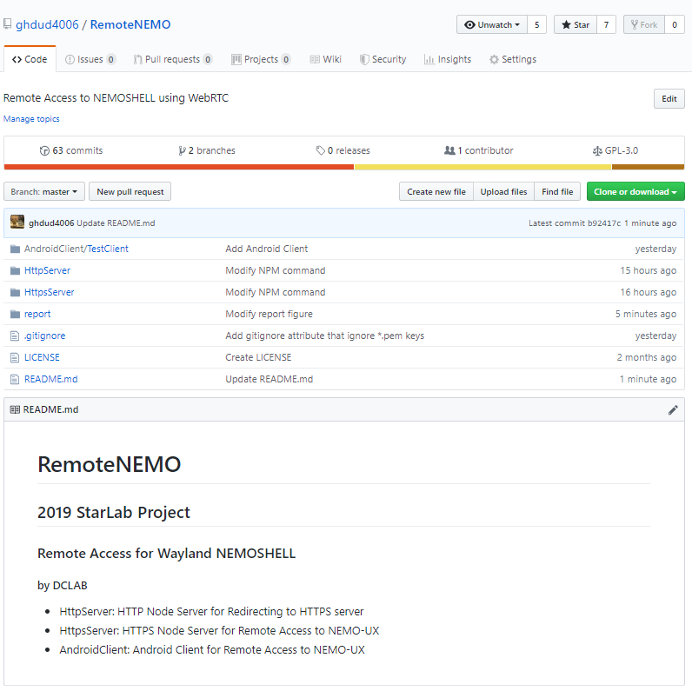

Slide 9
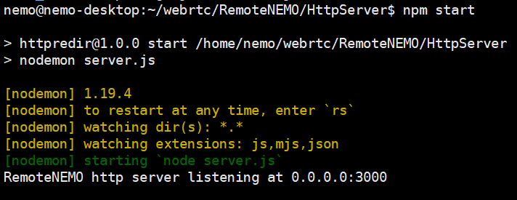
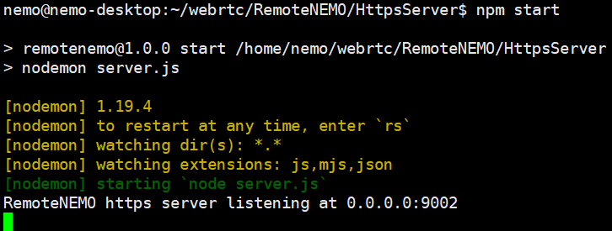

Slide 10
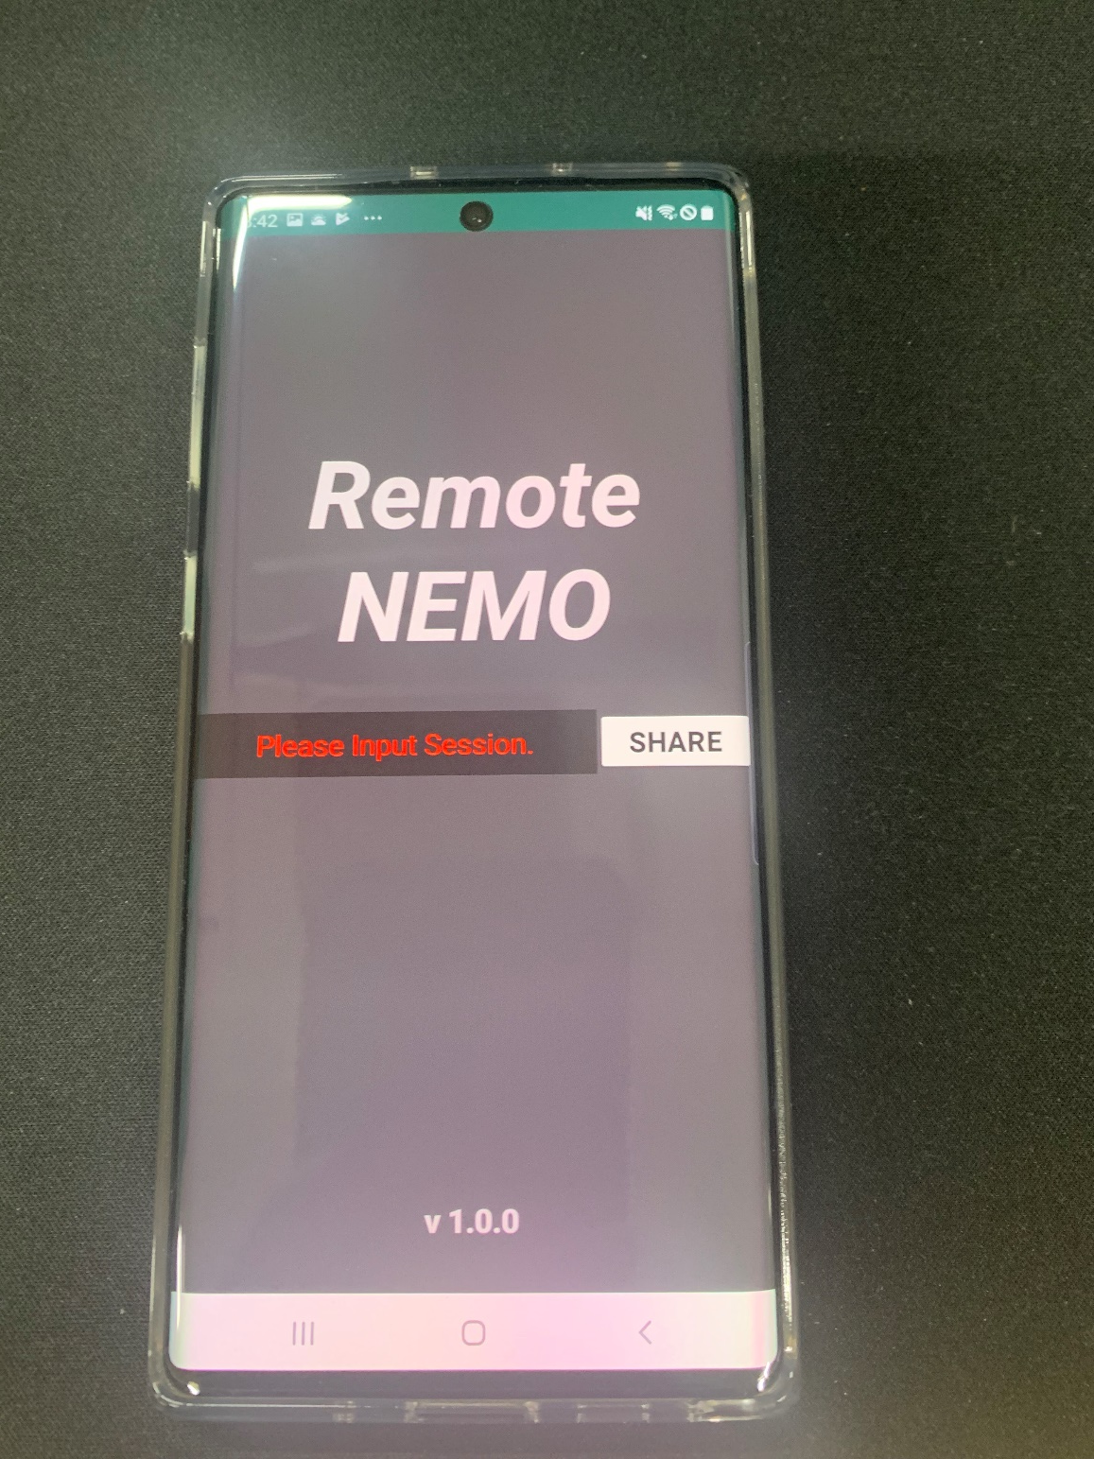
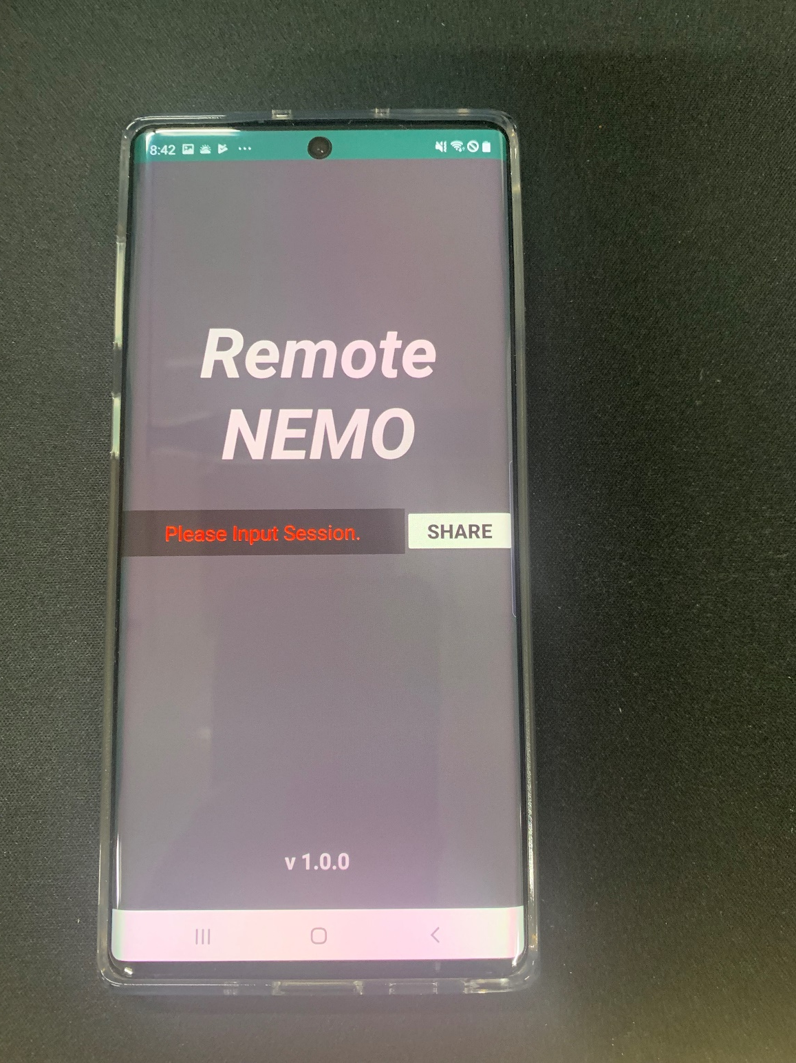

Slide 11
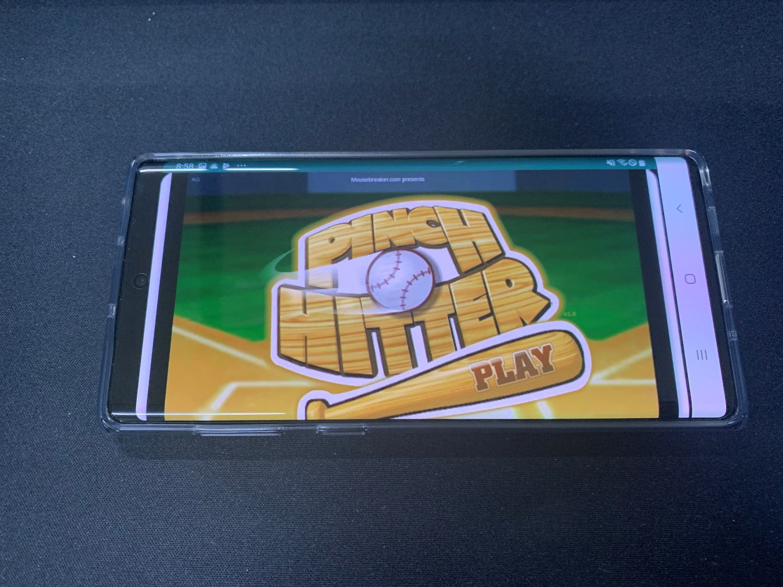

Slide 12
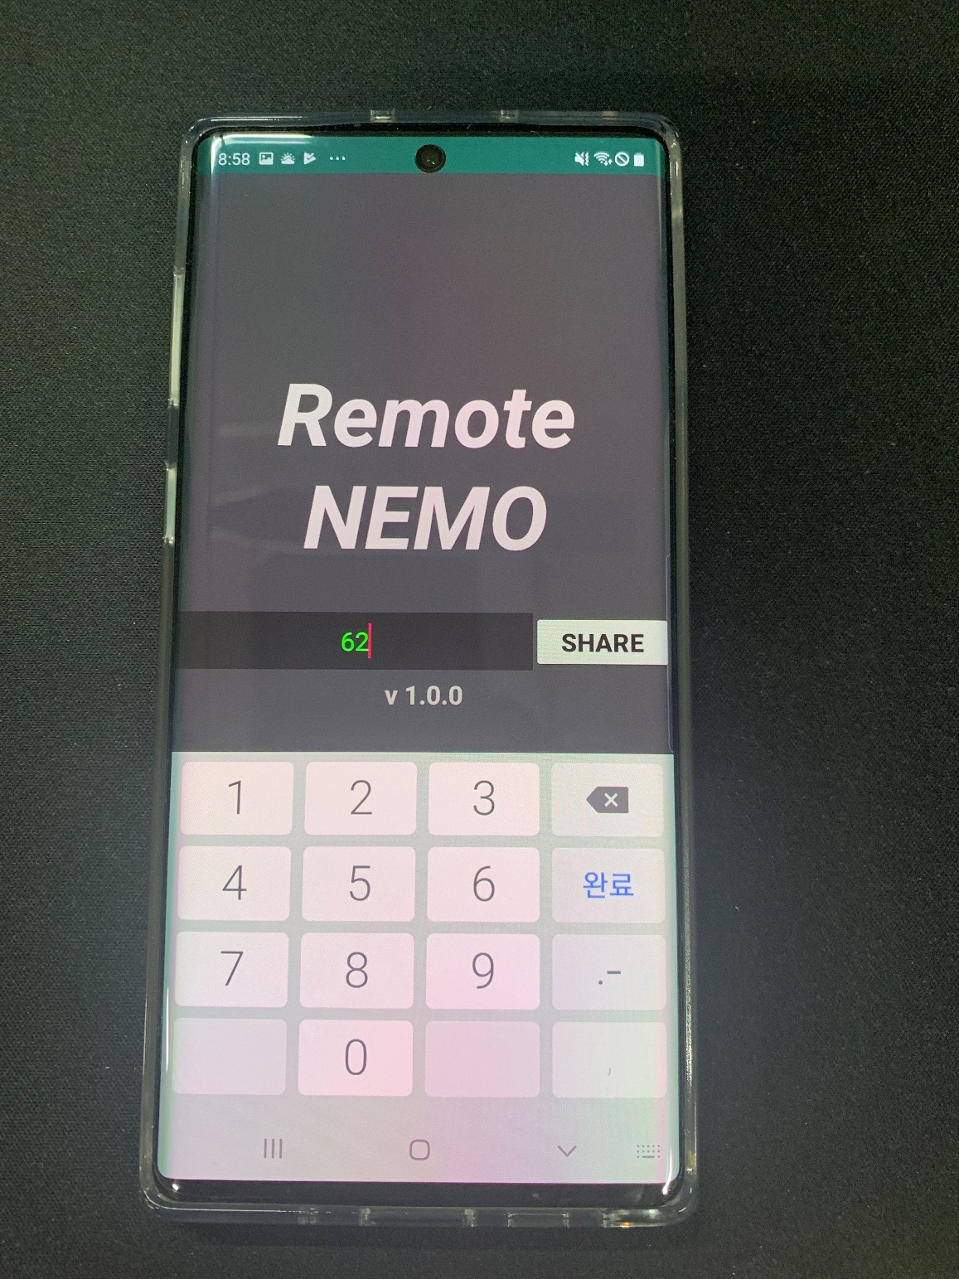

Slide 13
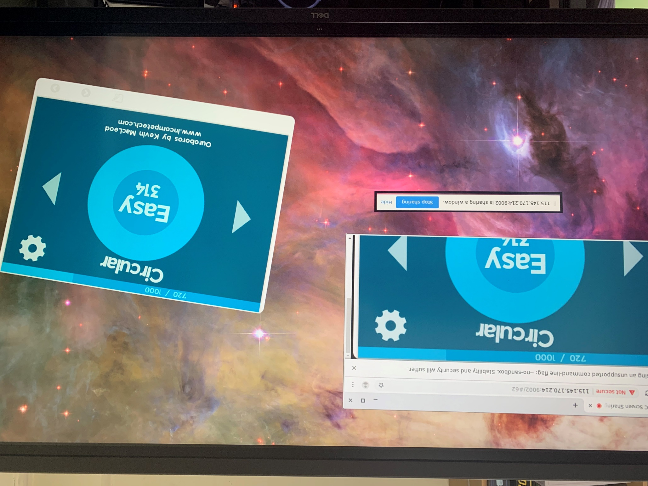

Slide 14
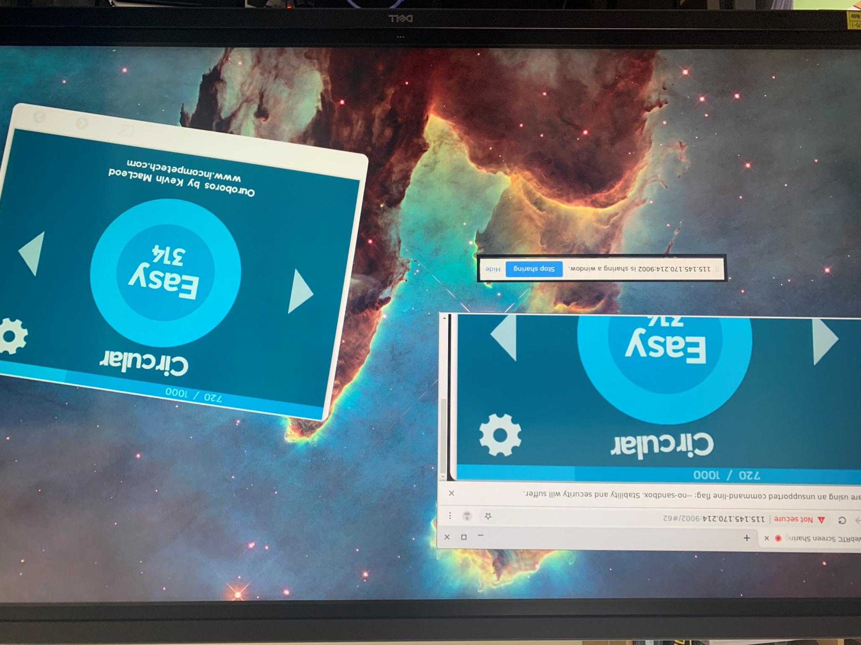

Slide 15
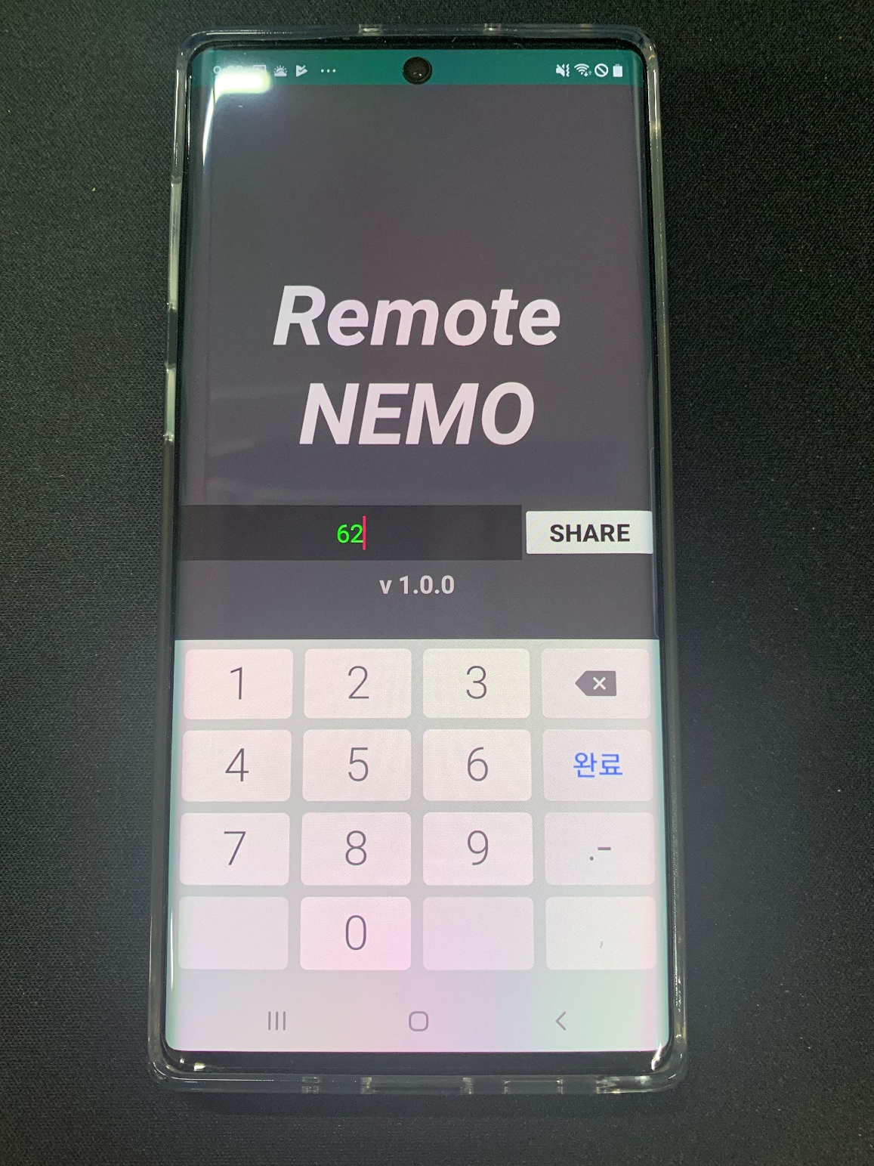

Slide 16
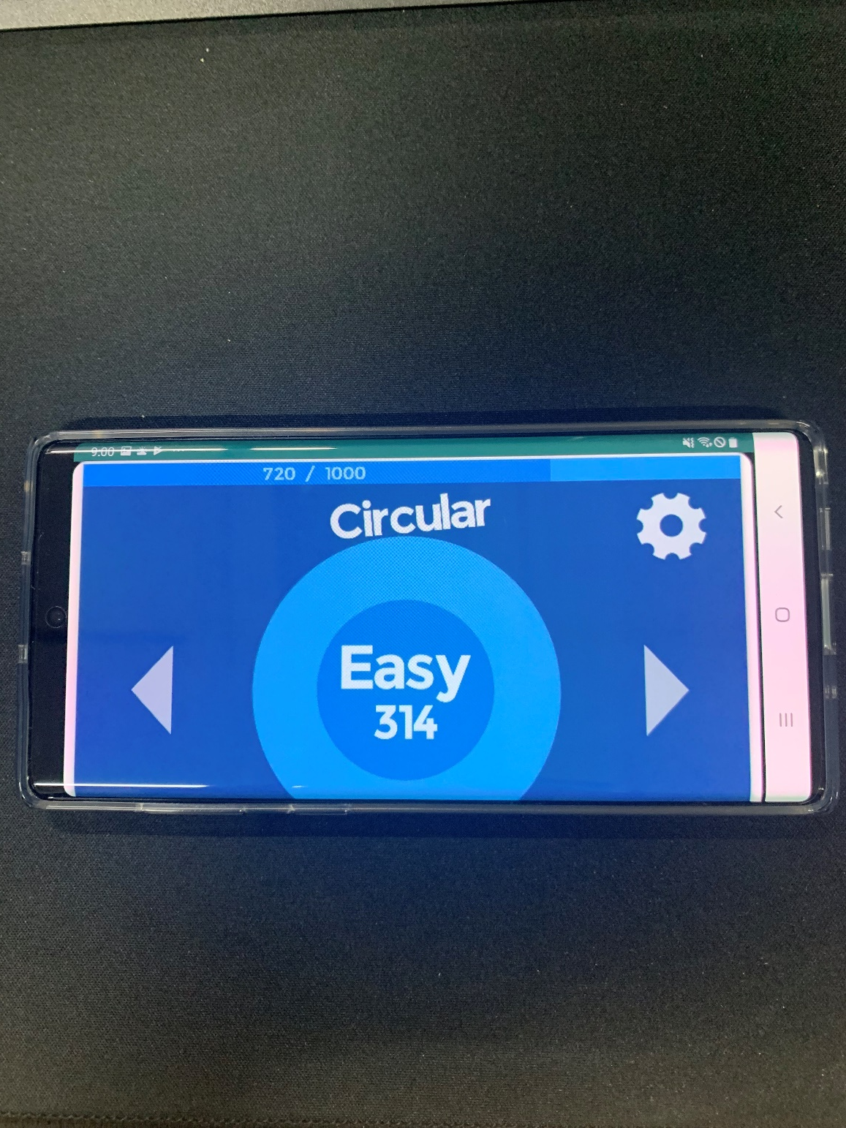

Slide 17
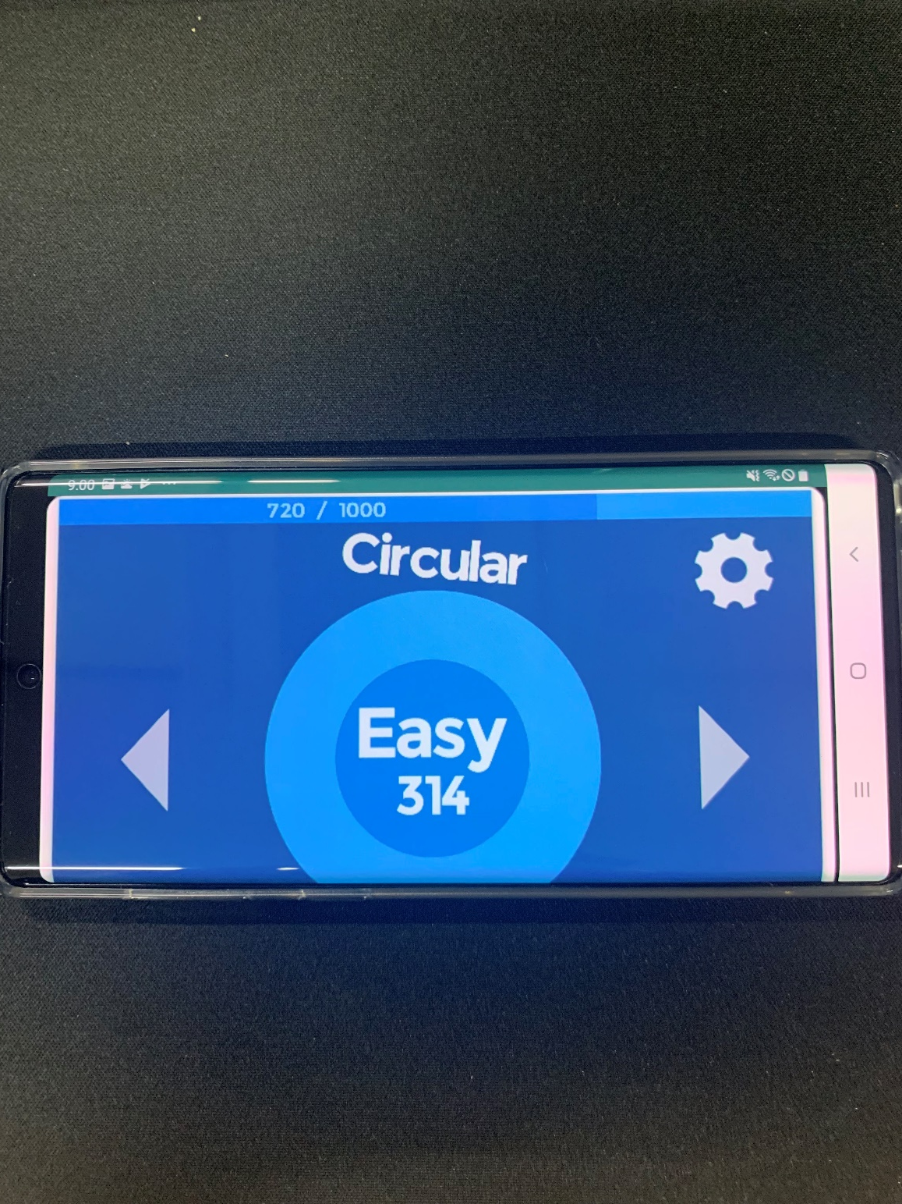

Slide 18
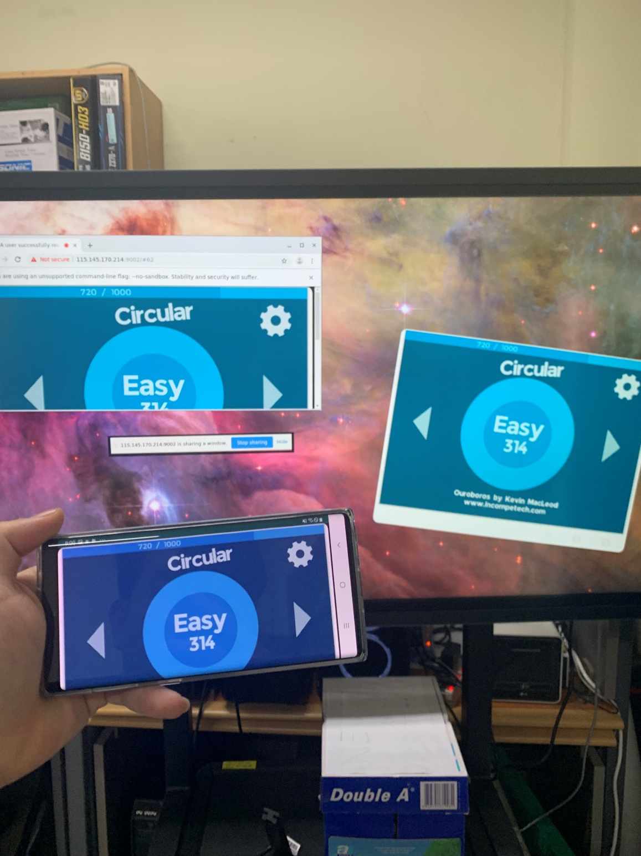

Slide 19
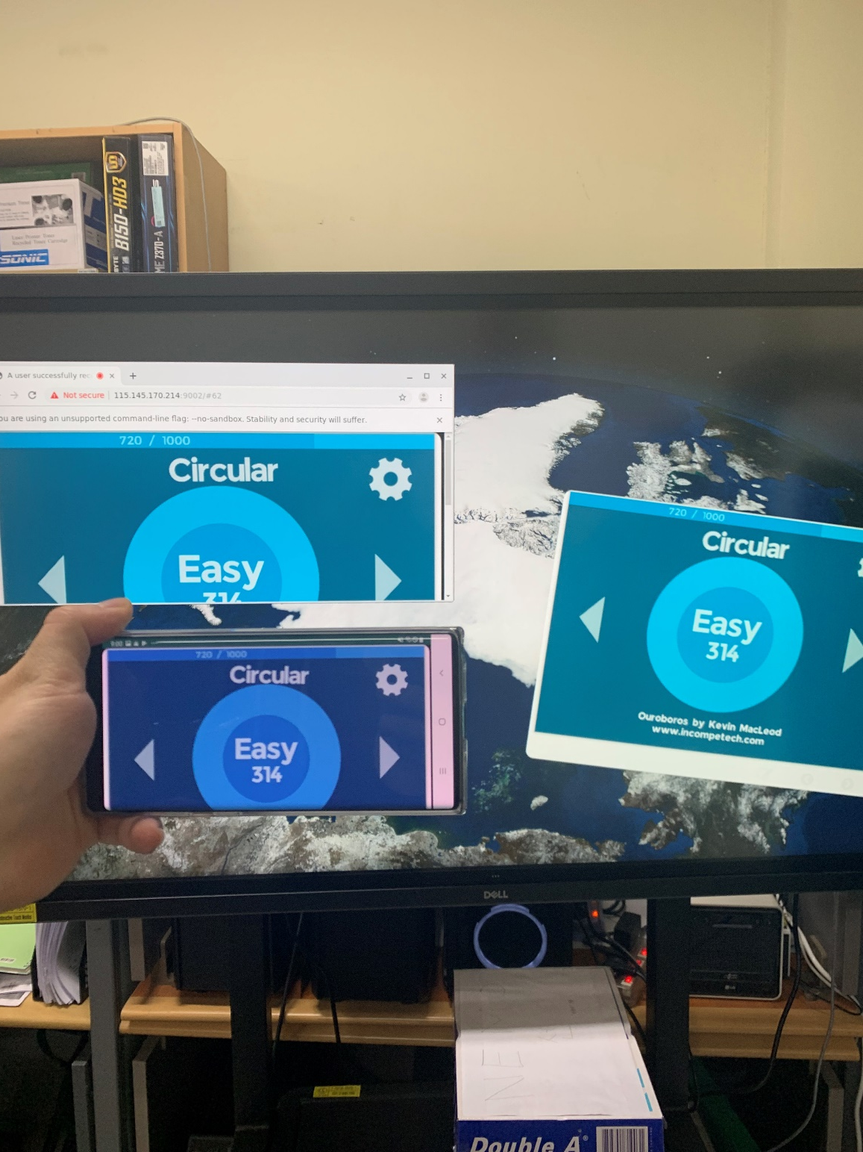

Slide 20
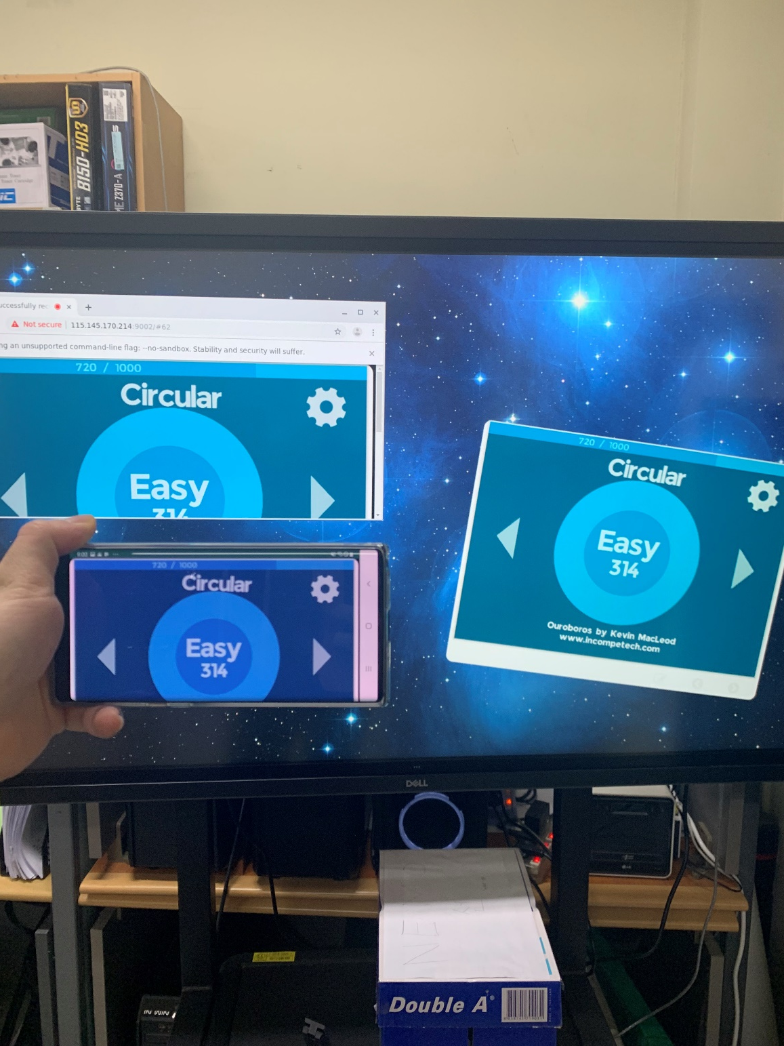

Slide 21
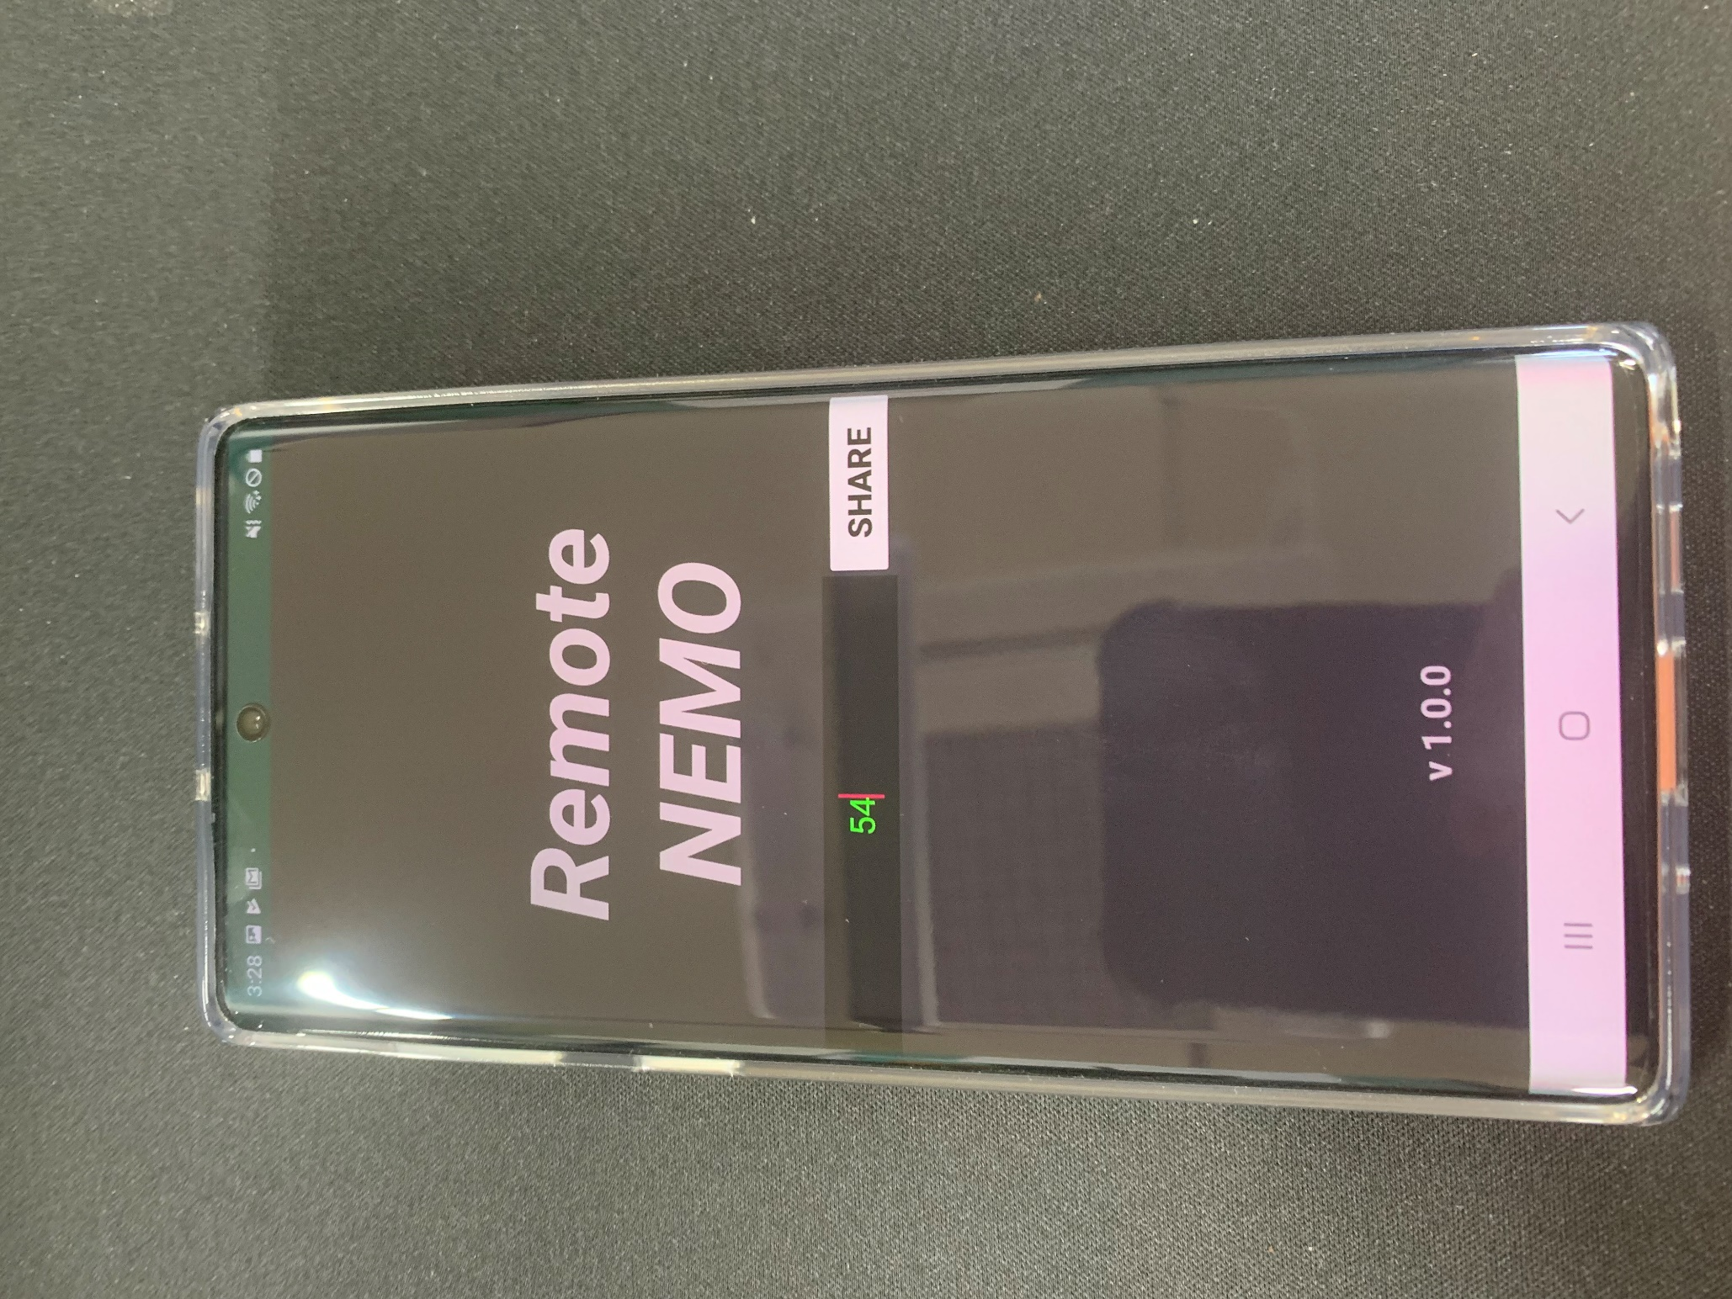

Slide 22
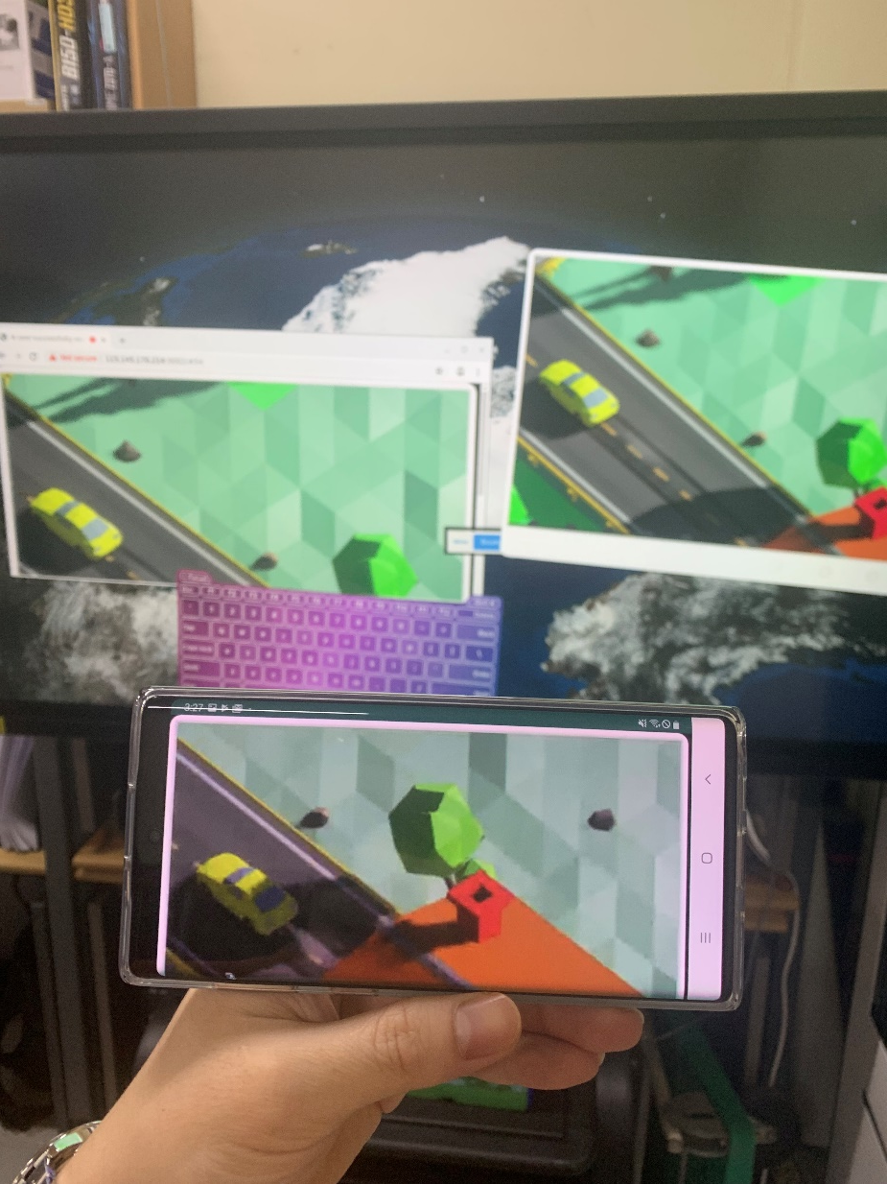

Slide 23
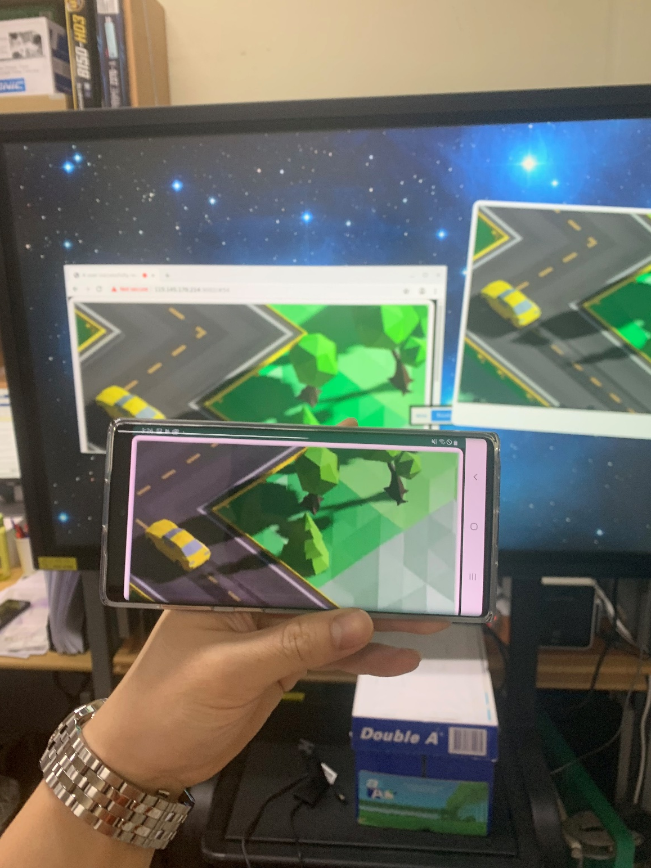

Slide 24
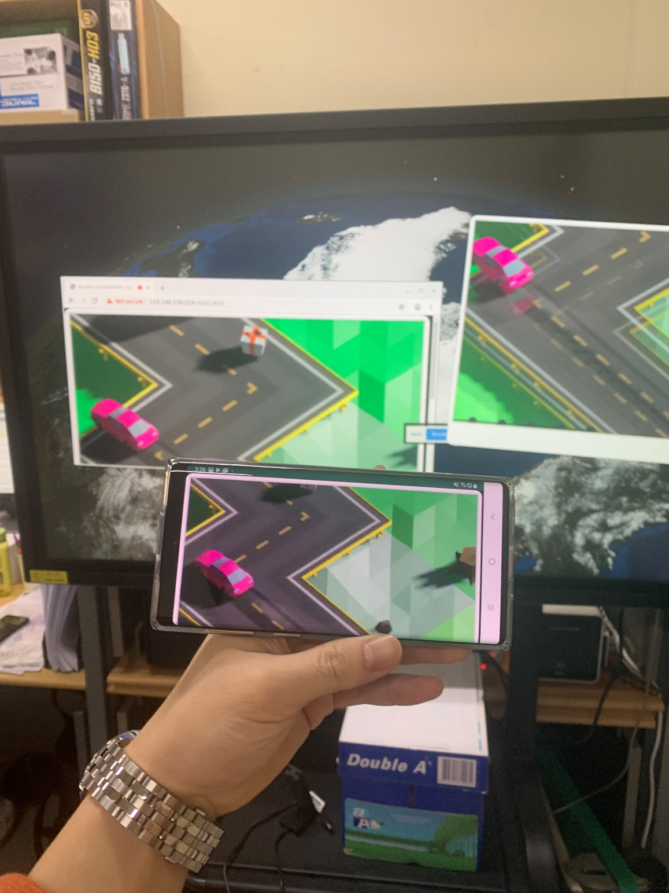

Slide 25
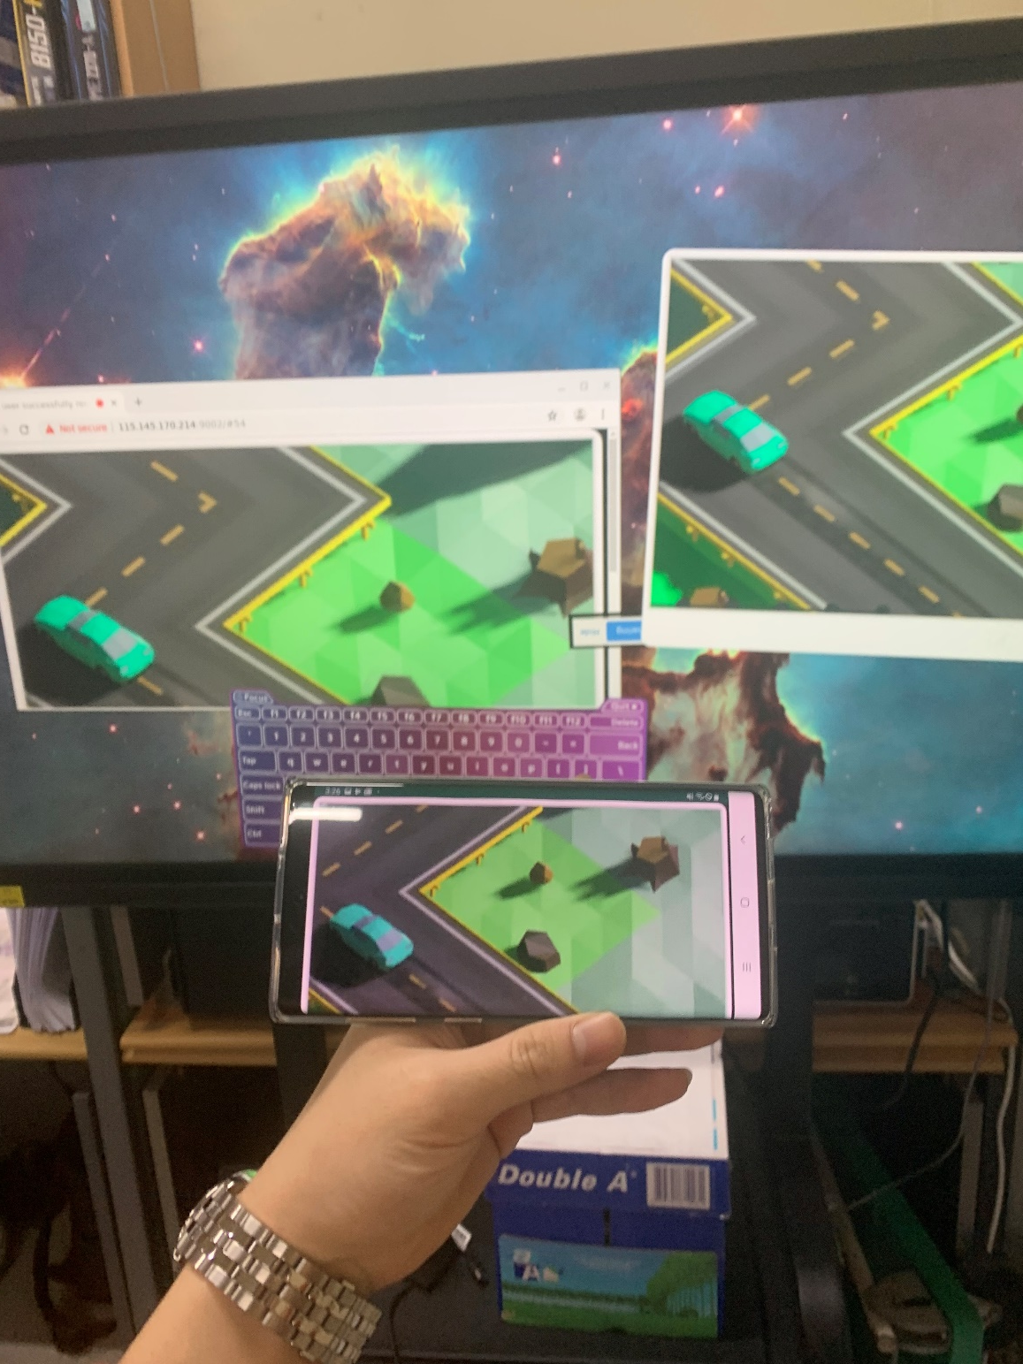

Slide 26
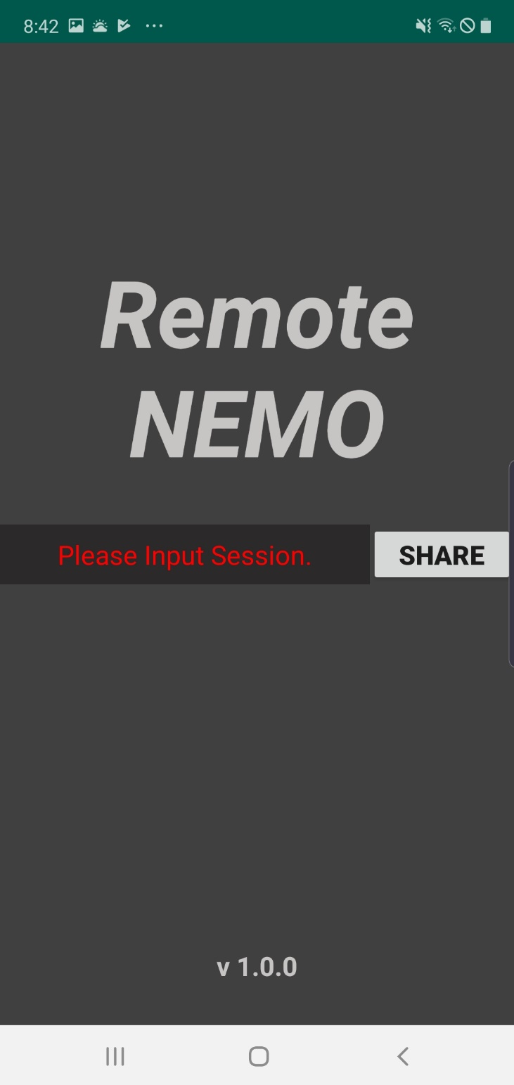

Slide 27
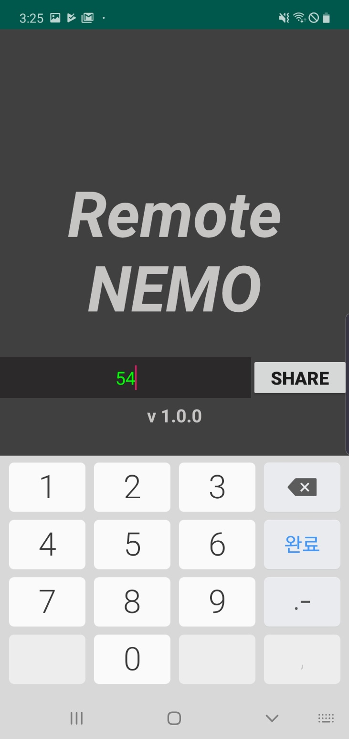

Slide 28
